Slide 1
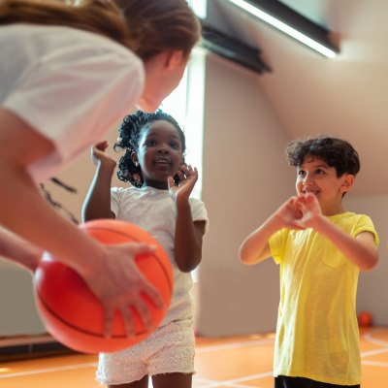
A Call for
Quality Coaching

Slide 2
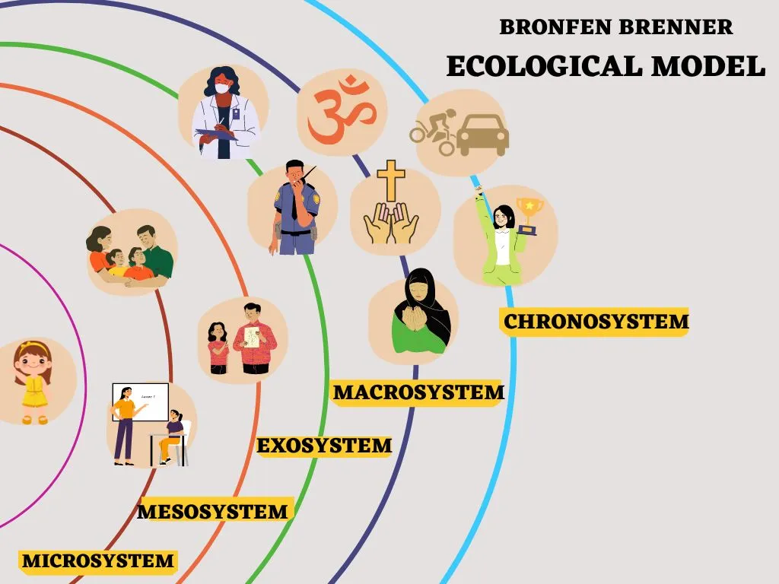
Bronfenbrenner’s Ecological Model
Recognizing the
Impact of the Coach
Achievement beliefs
Character development
Discipline
Fitness
Motivation
Lifetime health habits
Retention
Self esteem
Social skills
Sport skills
Achievement beliefs
Character development
Discipline
Fitness
Motivation
Lifetime health habits
Retention
Self esteem
Social skills
Sport skills

Slide 3
The Landscape in the U.S.
Notes:
https://www.aspeninstitute.org/wp-content/uploads/2022/11/National-Coach-Survey-Executive-Summary-FINAL.pdf

Slide 4
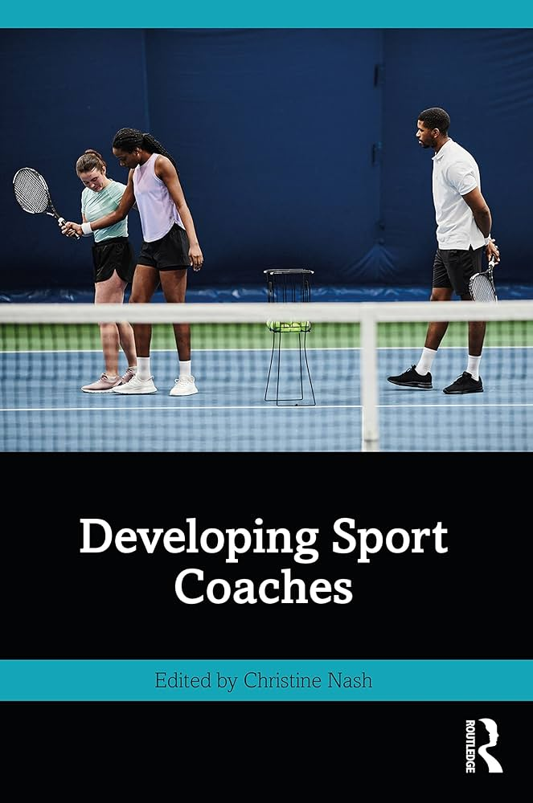
A Need to Know More about Coaches in Youth Sport
How many are there …really?
What is the ‘lifespan’ of a coach?
What is the turnover rate?
How do we find & recruit them?
Who are they?
Why are they engaged?
What is their investment?
What is their coaching ‘lifespan’?
Are they effective?
What do they need?
How to align their goals with the goals of sport for the athlete?

Slide 5
A Call to Align Initiatives in Support of Quality Coaching

Slide 6
Thank You
info@USCoachExcellence.org

