Slide 1
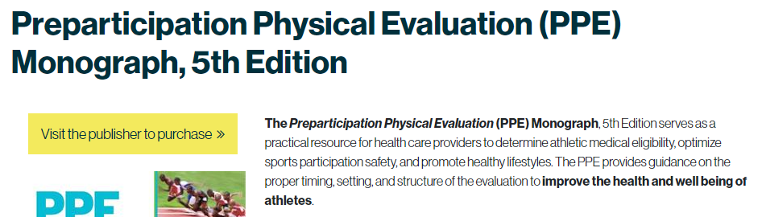
Randall Dick FACSM, AATA, PAMA
The 240-page monograph offers recommendations on PPE timing, setting, structure, medical history and clearance. Also included are forms for history (in English and Spanish), physical examination, athletes with disabilities and medical eligibility
Developed by : Endorsed by :
American Academy of Family Physicians (AAFP) National Athletic Trainers’ Association (NATA)
American Academy of Pediatrics (AAP) National Federation of State High School Associations
American College of Sports medicine (ACSM)
American Medical Society for Sports medicine (AMSSM)
American Orthopedic Society for Sports medicine (AOSSM)
American Osteopathic Academy of Sports Medicine (AOASM)

Slide 2
Other Highlights of the 5th Edition Sport PPE Monograph
Mental health, an unrecognized problem for athletes.
New guidance on the care of transgender athletes.
The female athlete triad energy availability, menstrual health and bone mineral density.
New musculoskeletal tests for risks of patellofemoral and ACL injuries.
The importance of exercise for children with special needs.

Slide 3
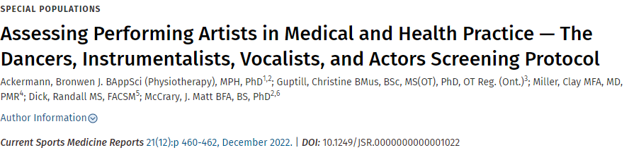
Performing artists are athletes. Like athletes, performing artists practice and/or perform most days with little off season, play through pain, “compete” in challenging environments, and risk career-threatening injury.
Athletes and the Arts is a multiorganizational initiative linking the sport athlete and musician/performing artist communities. Performing artists of all ages and genre are an underserved population related to medical coverage, care, injury prevention, performance enhancement, and wellness.
Sports medicine professionals are a valuable resource for filling this gap by applying existing knowledge of treating sport athletes (nutrition, injury prevention) while gaining a better understanding of performers’ unique needs (hearing loss, focal dystonia) and environment. These applications can occur in the clinical setting and through developing organizational policies.
By better understanding the needs of the performing arts population and applying existing concepts and knowledge, sports medicine professionals can expand their impact to a new patient base that desperately needs support.

Slide 4
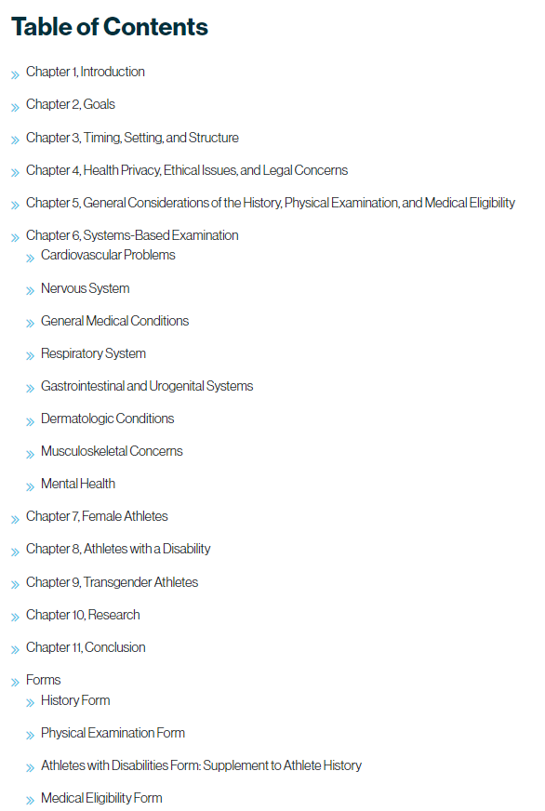
Sport PPE Monograph
DIVA
Exposure history (duration / intensity)
Medical history
Orthopedic history
Movement and Jaw / Face Disorders Assessment scales
Fitness
Performance Anxiety
Psychology history
Vocal Health surveys
Audiological Screening
DIVA PPE Physical Exam

Slide 5
DIVA Training and Ongoing Refinement
Since this tool was developed in 2016, it has been subsequently modified and refined annually to its current form based on ongoing consultations with domain experts in PAMA.
The intention is for this preparticipation screening to remain a “living tool” that can be modified in the future to include new effective assessment techniques as appropriate.
Training in the preparticipation physical examination is included as a core component of the Essentials of Performing Arts Medicine continuing education course, developed and delivered as a joint PAMA and ACSM initiative.
PROPOSED ACTION:
Have the 6 organizations involved in the development / updating of the sport PPE monograph PLUS select performing arts organizations develop a similar document or addendum that applies to performing artists.

