Slide 1
Characterizing the Gait Profiles of Sexually-Immature Pediatric Patients Following Anterior Cruciate Ligament Reconstruction
Elizabeth Bjornsen, MS
PhD Candidate

Slide 2
Acknowledgments and Funding Sources
Co-Authors:
Troy Blackburn, PhD
Winter Earnhardt
Jason Franz, PhD
Zachary W. Horton, MS
Darin Padua, PhD
Sandra Shultz, PhD
Brian Pietrosimone, PhD
22-01803
1R21AR067560-01

Slide 3
Osteoarthritis Development is Common Following ACLR
ACLR
Early Osteoarthritis Development
Disability and Loss of Knee Function
OVERALL: 74.6/100,000 ACLR PY
13-17 AGE GROUP: 96.3/100,000 ACLR PY
Herzog et al. Sports Health (2018)
Potential for greater years lived with disability
Ackerman et al. Osteoarth and Cartil (2015)
1 in 3 will develop post-traumatic osteoarthritis within the 1st decade
Luc-Harkey et al. JAT (2014)

Slide 4
Current State of ACL Biomechanics Research
Previous research has focused on adult or combined adult/pediatric patient populations
GAIT BIOMECHANICS
OSTEOARTHRITIS DEVELOPMENT AND KNEE SYMPTOMS
Aberrant gait biomechanics within 1st 12 months post-ACLR Davis-Wilson et al. MSSE (2020)
Slater et al. JAT (2017)
Hart et al. B J Sports Med (2016)
Aberrant gait biomechanics linked to linked to PTOA development
Pfeiffer S et al. MSSE (2017)
Pietrosimone B et al. J Ortho Res (2016)
Wellsandt E et al. Am J Sports Med (2016)
GAIT RETRAINING
Evans-Pickett A et al. Clin Biomech (2020)
Luc-Harkey BA et al. J Biomech (2018)
Munsch AE et al. PeerJ (2020)

Slide 5
Incidence of Pediatric ACL Injury
2.3% annual increase of ACL injury
Beck et al., Pediatrics (2017)
~18% increase for 10-14 and 15-19 age groups (2007-2011)
Werner et al., J Ped Ortho (2016)
Greater likelihood of concomitant injuries and 3x greater risk of retear vs. adults
Werner et al., J Ped Ortho (2016)
Faunø et al., Ortho J Sports Med (2014)
Long-term outcomes in pediatrics are poorly understood
Allahabadi S et al. Ortho J Sports Med (2021)

Slide 6
Implications for Long-term Outcomes in Pediatrics?
Incidence of pediatric ACL injury is increasing
Beck et al. Pediatrics (2017) ; Werner et al. J Ped Ortho (2016); Dodwell et al. Am J Sports Med (2014)
Greater disability for PTOA patients in comparison to idiopathic OA patients
Ackerman et al. Osteoarthr and Cartil (2015)
Greatest increase observed in females 15-16 year old
Beck et al. Pediatrics (2017)

Slide 7
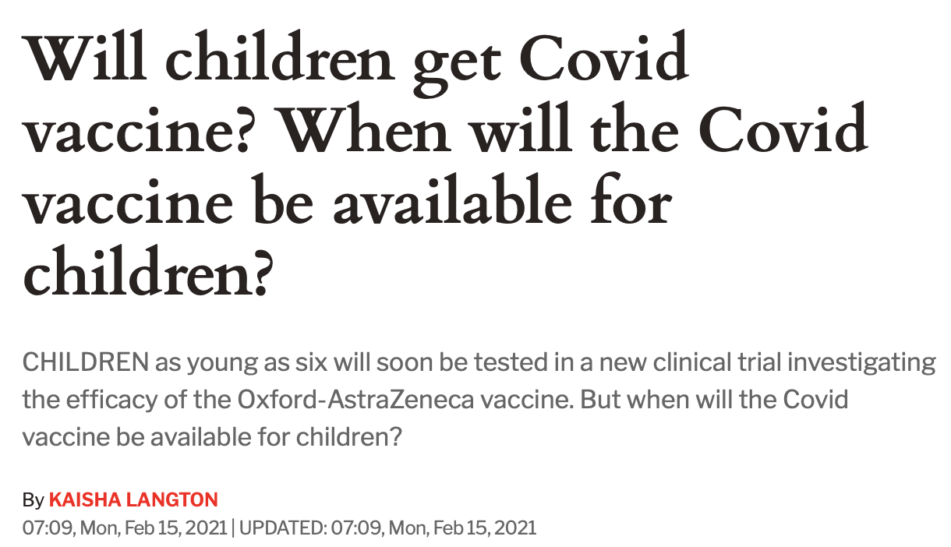
Pediatrics Should Not be Treated as Adults

Slide 8
Key Limitations of Previous Work
Lack of biomechanical analyses in pediatrics
One study in older pediatrics 16-18 yrs. old
Lisee et al. J Athl Train, 2022
Lack of rigorous study design
Chronological Age vs. Maturation Stage
Control Groups

Slide 9
Purpose
To compare the biomechanical profiles of pediatric ACLR patients (defined as Tanner Stage I-IV) to uninjured, matched pediatrics and adult-matched ACLR patients.

Slide 10
Study Design
Pediatric Controls:
Tanner stage category; sex; Tegner Activity (±2 )
Pediatrics Self-Reported Tanner Stage (Tanner I-IV)
Early Puberty (Tanner Stage I-II)
Mid/Late Puberty (Tanner Stage III-IV)
Previously collected Adult ACLR participants
Pediatric ACLR
Adult ACLR:
Sex, Tegner Activity (±2), months post-ACLR (±2 )
Biomechanics Assessment
ACL Injury
ACLR
6 months
24 months

Slide 11
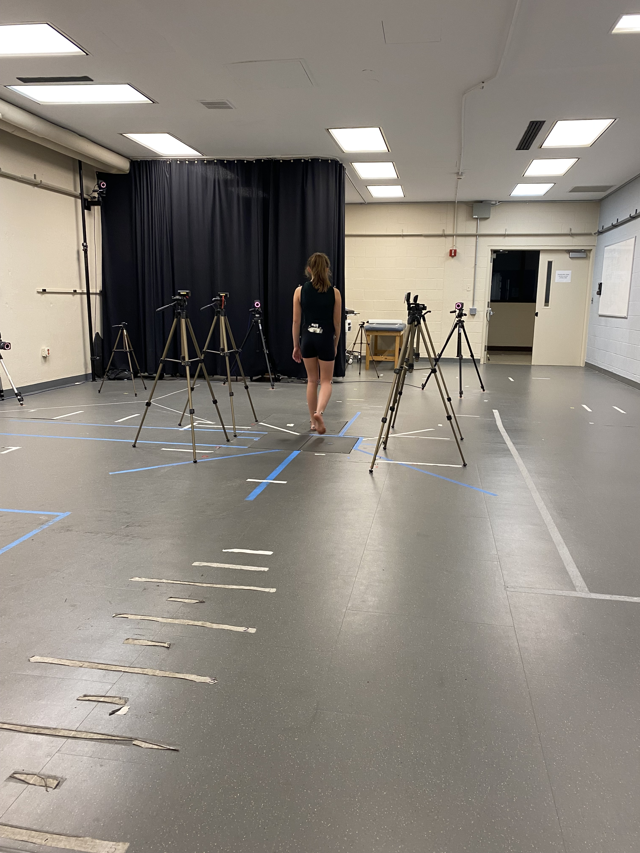
Methods- Gait Biomechanics Collection and Analysis

Slide 12
Results: Participants
 | Pediatric ACLR (n=15) | Pediatric Control (n=15) | Adult ACLR (n=15)
Age (yrs.) | 15 ± 1 | 15 ± 1 | 23 ± 3
Months Post ACLR | 10 ± 5 | NA | 10 ± 5
Sex (% Female) | 46% (n=7) | 46% (n=7) | 46% (n=7)
Primary Sports:
Combined 57%

Slide 13
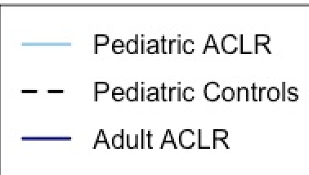
Vertical Ground Reaction Force
Peds ACLR vs Peds Control:
↓ vGRF during early stance (7-14%, d=-1.2; -6.0% BW) and (16-26%; d=1.3; -7.0% BW)
vGRF (%BW)
Peds ACLR vs Adult ACLR:
↓ vGRF in midstance (54-62%; d=-1.1; -6.0% BW)
↑ vGRF in late stance (90-93%; d=-1.0; +5.0% BW)
vGRF (%BW)
% Stance Phase (1-101%)
% Stance Phase (1-101%)

Slide 14
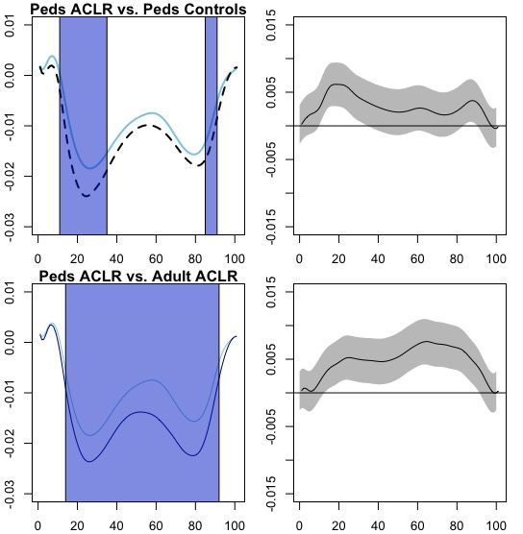
Knee Abduction Moment
Peds ACLR vs Peds Control:
↓ KAM during early stance (11-35%, d=-1.9; -0.001)
↓ KAM in mid to late stance (85-91%; d=1.2; -0.004)
KAM (BW x height)
Abduction (-). Adduction (+)
Peds ACLR vs Adult ACLR:
↓ KAM throughout stance (14-92%; d=2.3; -0.01)
Abduction (-). Adduction (+)
KAM (BW x height)
% Stance Phase (1-101%)
% Stance Phase (1-101%)

Slide 15
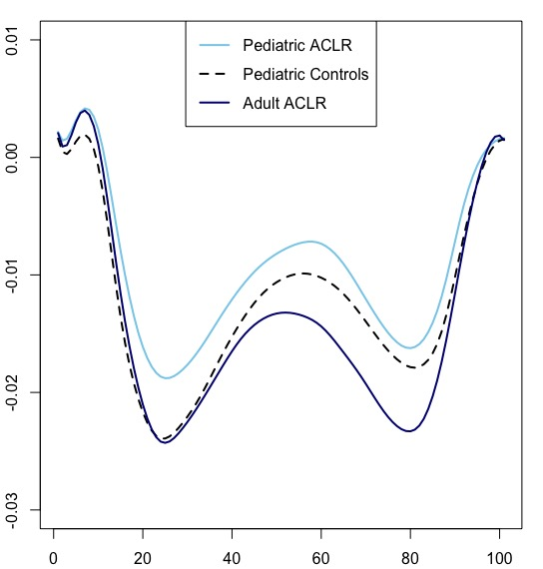
Lesser KAM Loading Profiles May Be Linked to a Deleterious Biological Response
KAM is a proxy measure for knee compartment loading
Andriacchi et al., 1994
In adults, lesser peak KAM within 12 months is linked to biological markers consistent with early osteoarthritis development
Pietrosimone et al. 2018
Pfeiffer et al. 2018
Future work should assess link between KAM and biological markers in pediatric ACLR patients
Internal KAM (BW x height)
Abduction (-). Adduction (+)
% Stance Phase (1-101%)

Slide 16
Limitations:
Preliminary, cross-sectional analysis
Concomitant injuries
ACLR and graft type

Slide 17
Future Directions
Clinical conversation with pediatric ACLR patients/parents primarily focuses on return-to-sport
Long-term consequences are unknown
Determine link between unique biomechanical profiles and clinically relevant knee symptoms
No research has assessed factors associated with poor outcomes in adults

Slide 18
Conclusion
Pediatric ACLR patients demonstrated minor differences in vGRF profiles but substantially lesser KAM loading than adult ACLR patients and may require developmentally-appropriate gait interventions post-ACLR.

Slide 19
Questions?
Contact Info:
Elizabeth Bjornsen, MS
ebjornse@email.unc.edu

