Slide 1


Podiatric Sports Medicine Update
Alicia Canzanese, DPM, ATC, FAAPSM, DABPM

Slide 2
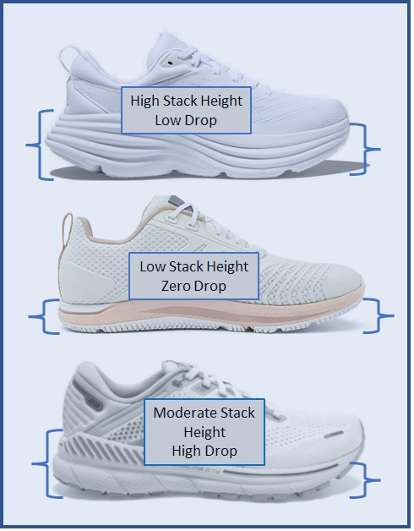
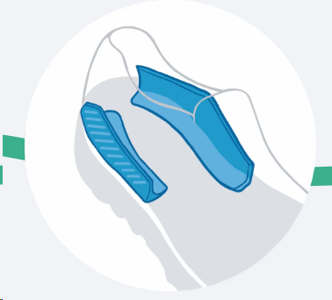
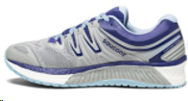
Updates and Trends in: Running Shoe Anatomy and Geometry
Wider and Rounder Tox Box
Increasing stack heights
Lower Offset
Lightweight responsive cushioning
Forefoot rocker
Super Shoes
Changes in Stability Shoes
  Wider base
  Rocker geometry
  Eliminating stiff medial posts in the midsole
    Instead utilizing “guide rail”/”J-Frame” Type Systems
Notes:
thick, bouncy, sole that propels you forward, but can also throw you sideways. “Running in supershoes is a much less stable environment,” says Jay Dicharry, physical therapist, biomechanical researcher, and professor at Oregon State University. “If you have really good alignment and foot and ankle control, you might be OK, but if not, a supershoe will greatly magnify your instability. You’ll wind up with a considerable increase in stress—and if you have something borderline, it might push you over the threshold.”

Slide 3
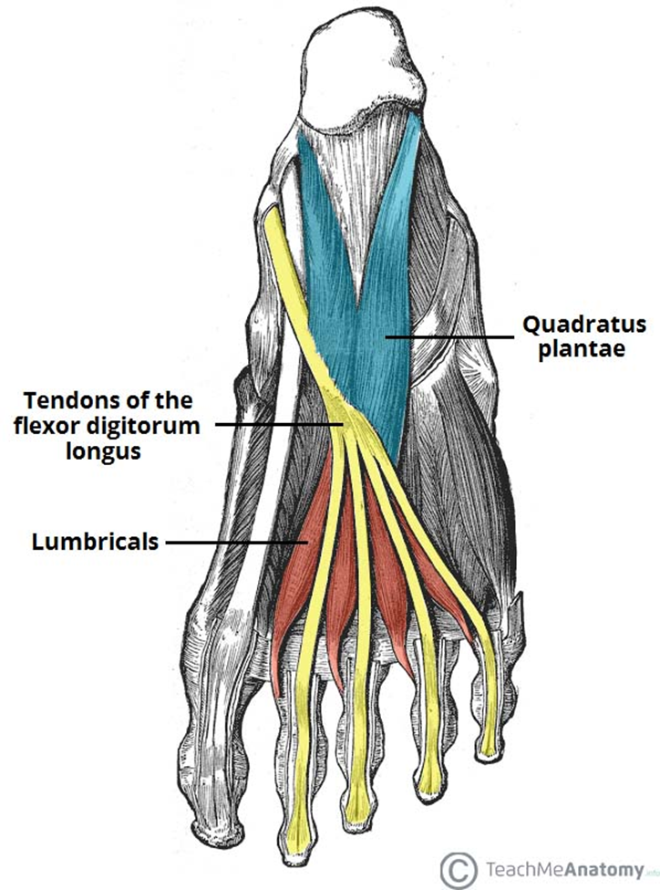
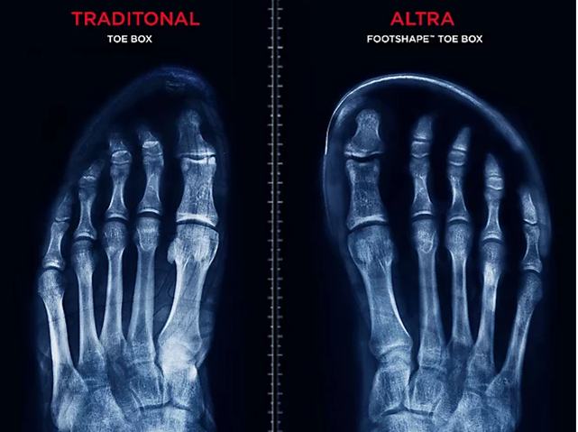
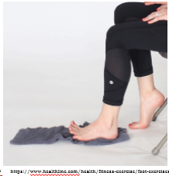
Shoe Geometry Changes Highlighting the Importance of Intrinsic Foot Muscle/“Foot Core” Strength
Purpose of Instincts Muscles:
    Dynamic Stabilizers of the foot (26 bones, 30 joints)
      4 layers of intrinsic muscles in the foot
    Control the velocity and degree of arch deformation
    Longitudinal and transverse arch
    Maintain the “foot dome”
    Encourage a more STJ Neutral position
    Stabilize the position and alignment of the digits during gait
Kinetic Chain: top effects bottom and bottom effects the top
  Coupled Dynamic muscle function doesn’t end at the ankle
  EBM: Sulowska-Daszyk, et al. 2020: “Impact of Short Foot Muscle Exercises on Quality of Movement and Flexibility in Amateur Runners”
    A Significant improvement in the Functional movement screen and Flexibility proximal to the foot was noted in the experimental group
Foot core and injury EBM:
  EBM Examples:
    Chang et al demonstrated with ultrasound that patients with unilateral plantar fasciitis had less total volume of the plantar intrinsic muscles in their forefoot region compared to their contralateral healthy limbs.
    Chronic Ankle Instability: Preliminary evidence. Intrinsic exercises + Balance exercises demonstrated improved dynamic balance and perceived function
    Supershoes can amplify instability for those with poor muscle control
Notes:
19 foot cosr musckes

Slide 4

The Heel Offset, Foot Strike and Injury Conversation
Heel strike → High offset and/or Higher Stack height
  Greater impact through knee/hip/back
  At contact there is more ankle dorsiflexion and knee extension
  Higher vertical load, lower shear stress at ankle
  Greater load on the Quadriceps
  Increased risk for: Anterior knee pain, Tibial Stress fractures, MTSS, plantar fasciitis?
Forefoot strike → low offset that can be low or high stack height
  Greater impact to MTPJ/Ankle
  Shorter Stride length
  At contact: ankle plantar flexion and more knee flexion
  Higher max peak force
  Greater eccentric load on the Gastroc-soleus
  Increased risk for Achilles tendinopathy*?, calf muscle strain, ankle, forefoot pathology
    HOWEVER: Long term forefoot strike has been shown protective toward the Achillies
Notes:
****yes I know I attempted to simplify and summarize a complex question into one slide
Shifting strike patterns shifts loads/forces, so its not an issue if which one leads to more injuries, it’s that they lead to different injury patterns

Slide 5

Current and Emerging Recommendations
If someone is switching shoe that >4 mm different than their current shoe, it is advisable to gradually transition to that new shoe
  If someone is switching to a different category of shoe, or to a different strike pattern, that should also be a gradual transition
Running Athletes should perform foot core exercises
    Especially if planning on running in a race day/performance shoe for events
More people are starting to suggest switching different types of shoes/strike patterns/surfaces as part of a training regimen to avoid repetitive loading on the same musculature
Help prevent overuse/overutilization of supershoes and performance shoes to prevent injury
There is NO perfect shoe, and we should not be recommending the same shoe to everybody
    Different shoe features lead to different load patterns and therefore different injuries
    Shoes suggestions should always be individualized
Notes:
Golden harper suggests moving around more on training runs
Amol Saxena reseaach on supershoes
”I’ve had people break or tear things just in one run in the shoes.”

