Slide 1

Extracorporeal Shockwave Therapy for Tendinopathy
John Cianca, MD, FAAPM&R

Slide 2
RPWT/ESWT
Tendinopathy is a common MSK condition
Traditionally treated with NSAIDs, PT driven exercise or more invasive techniques
  The former takes time away is slow and requires reduced activity
  The latter is invasive and requires down time
RPWT/ESWT is an adjunctive therapy to PT that reduces pain and allows a faster progression to therapy
It avoids the downtime of invasive therapies and is cost effective

Slide 3
RPWT/ESWT
Utilizes mechanical and ultrasonic energy
RPWT delivers mechanical energy. Relatively shallow penetrance
RPWT uses varied delivery heads for different surfaces, depths and tissue problems
ESWT delivers ultrasonic energy with pinpoint focus.
ESWT penetrates deeper and is more intense

Slide 4
ESWT: Quick Relief; Less Recovery Time
3-5 sessions, 1 per week
May see symptom reduction as soon as treatment #1
Stimulates healing response
No side effects
Non-invasive
Patient controlled pain during treatment
Aiming for 4-6 level pain during treatment
Avoid acute inflammatory phase of a condition

Slide 5
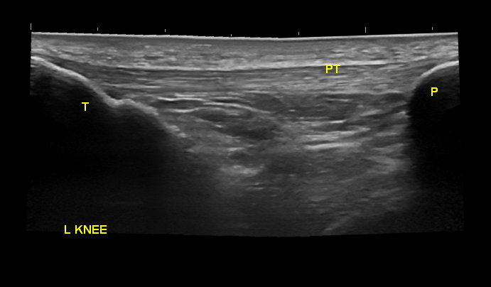
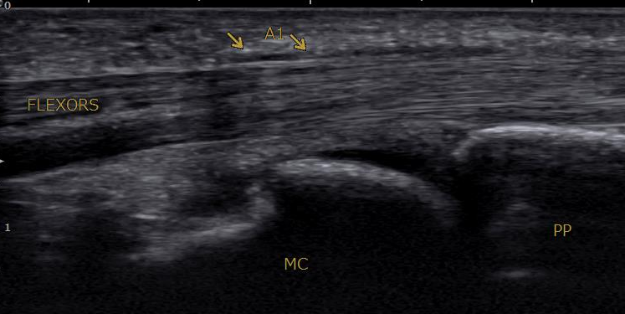
Conditions Treated
Chronic tendinopathy
Muscle tightness and trigger points
Trigger finger

